Slide 1
BCCA figures
March 13 2025

Slide 2
Data % to report
X2.1.Flow.Type n prop
<chr> <int> <dbl>
1 Biotic 113 0.551
2 Human movement 21 0.102
3 Physical 38 0.185
4 Sociocultural 33 0.161

Slide 3
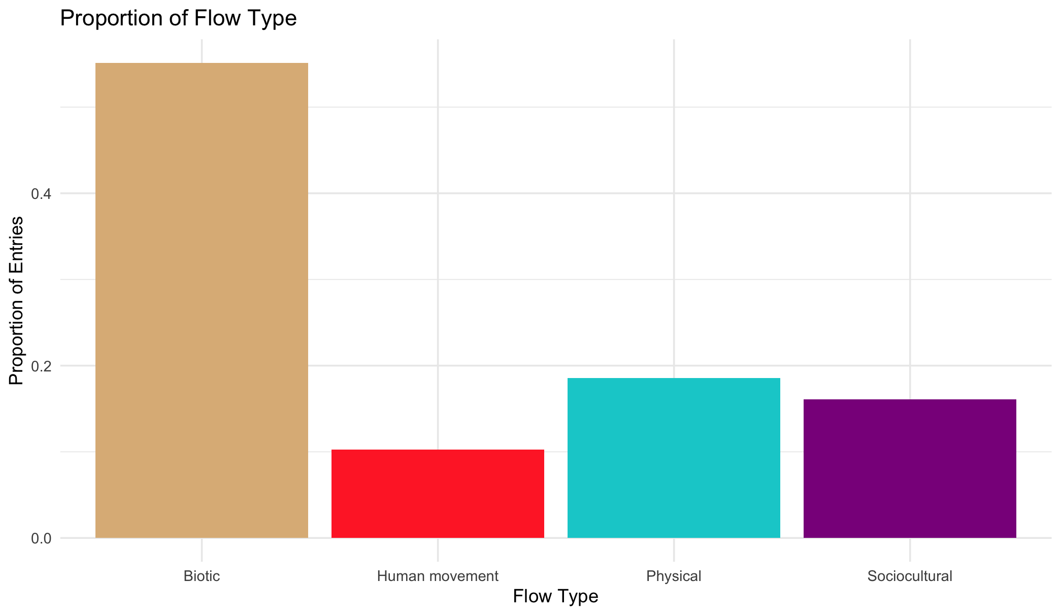

Slide 4
Multiple flows
Another.Flow. n prop
1 No 168 0.820
2 Yes 37 0.180

Slide 6
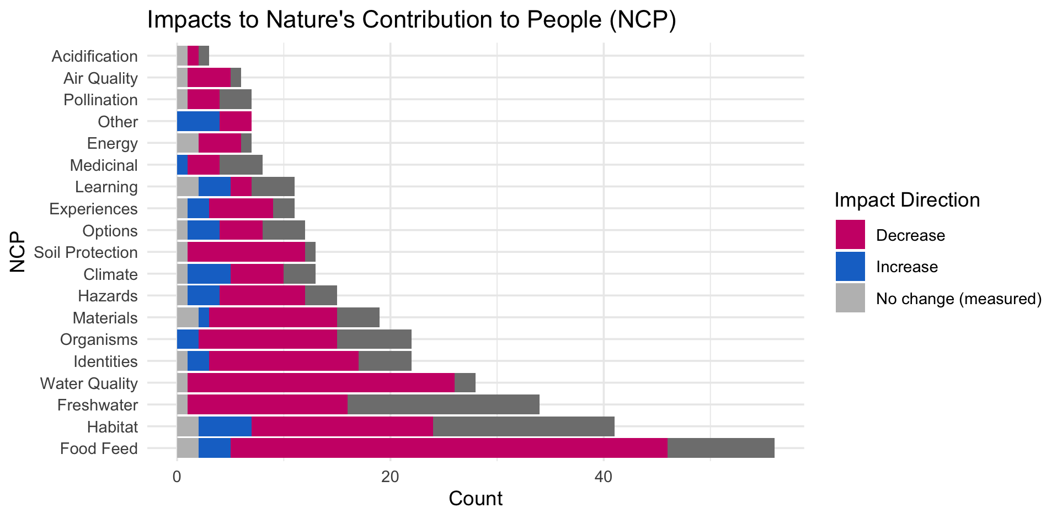

Slide 10
OLDER:

Slide 12
At least 5 entries – top – to get stats on % of entries or papers on these:

Slide 13
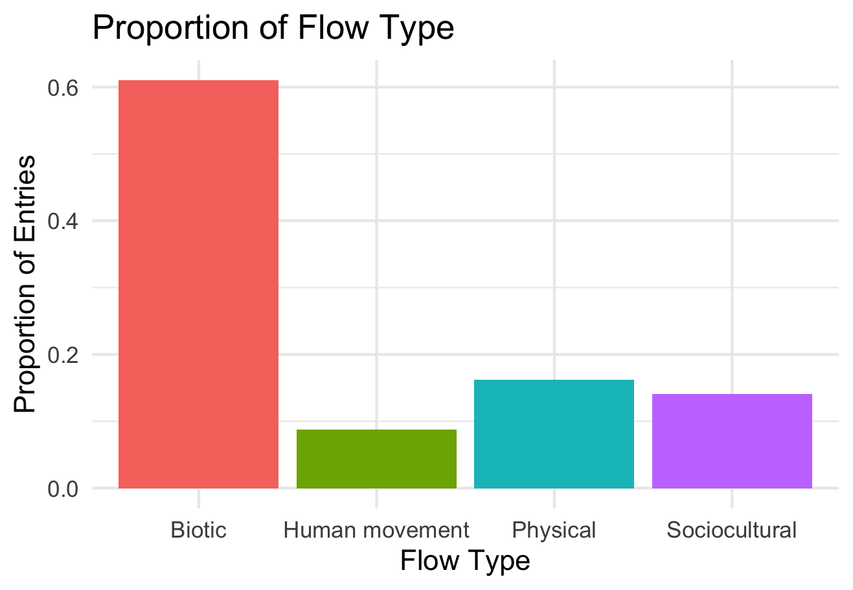

Slide 14
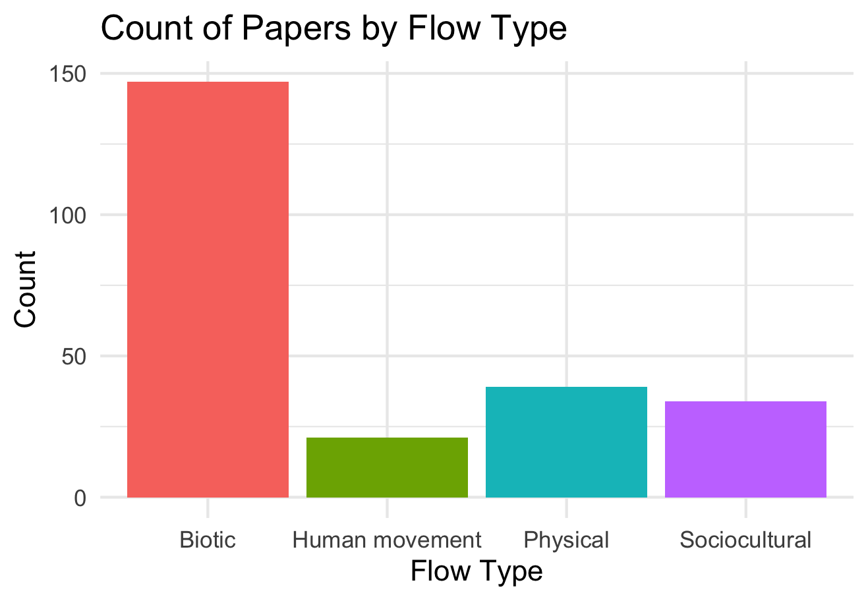

Slide 15
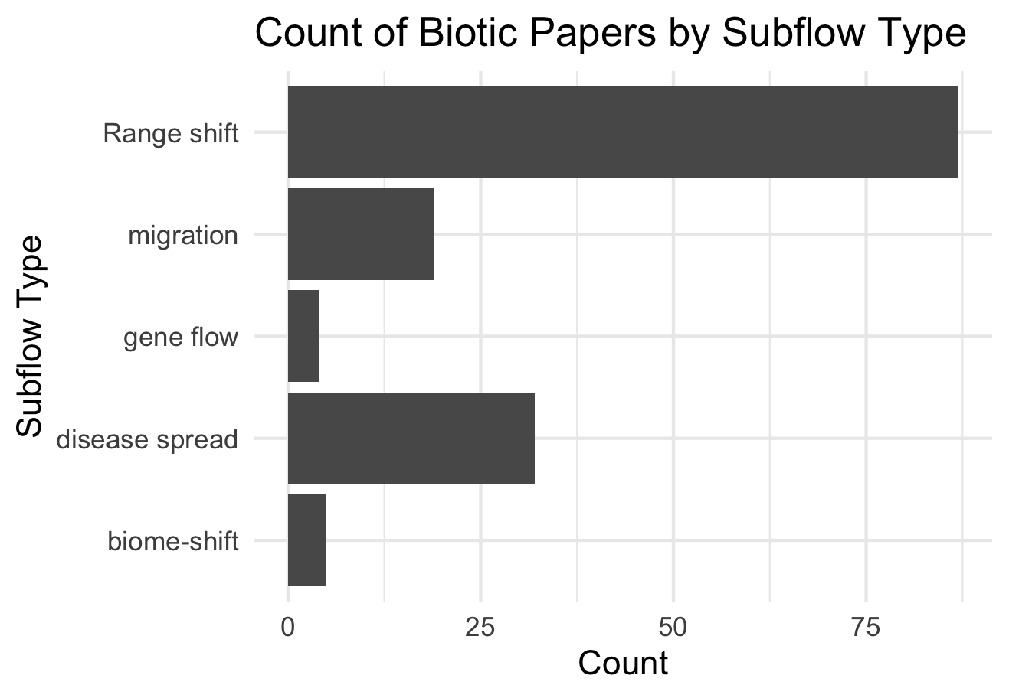

Slide 16
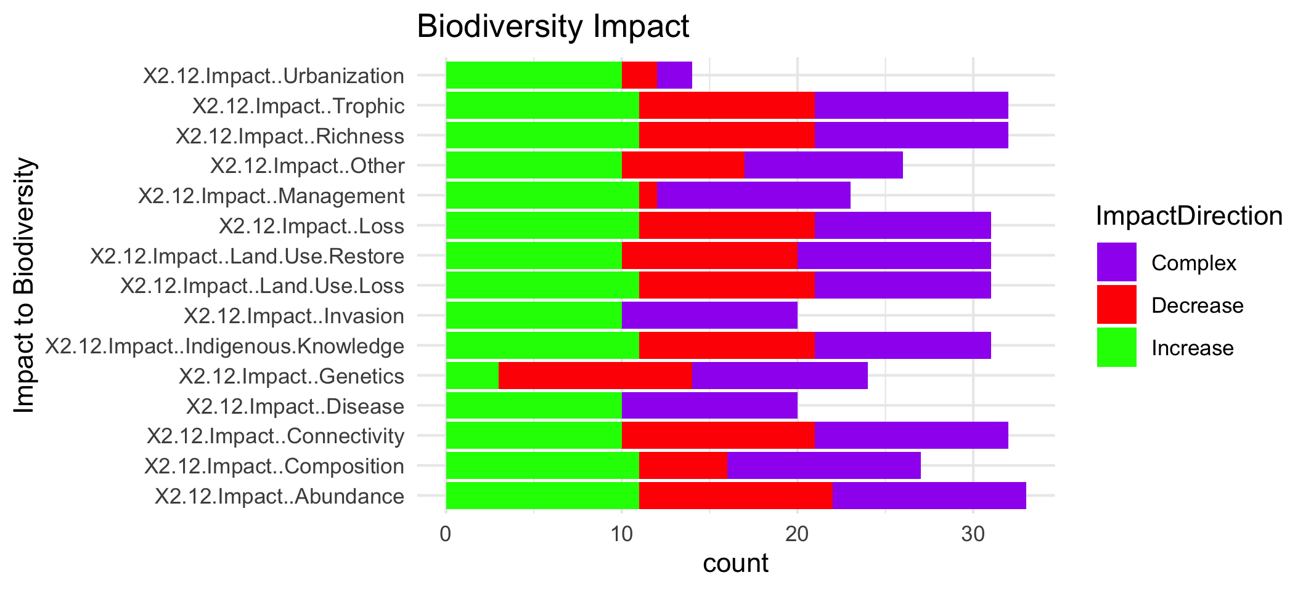

Slide 18
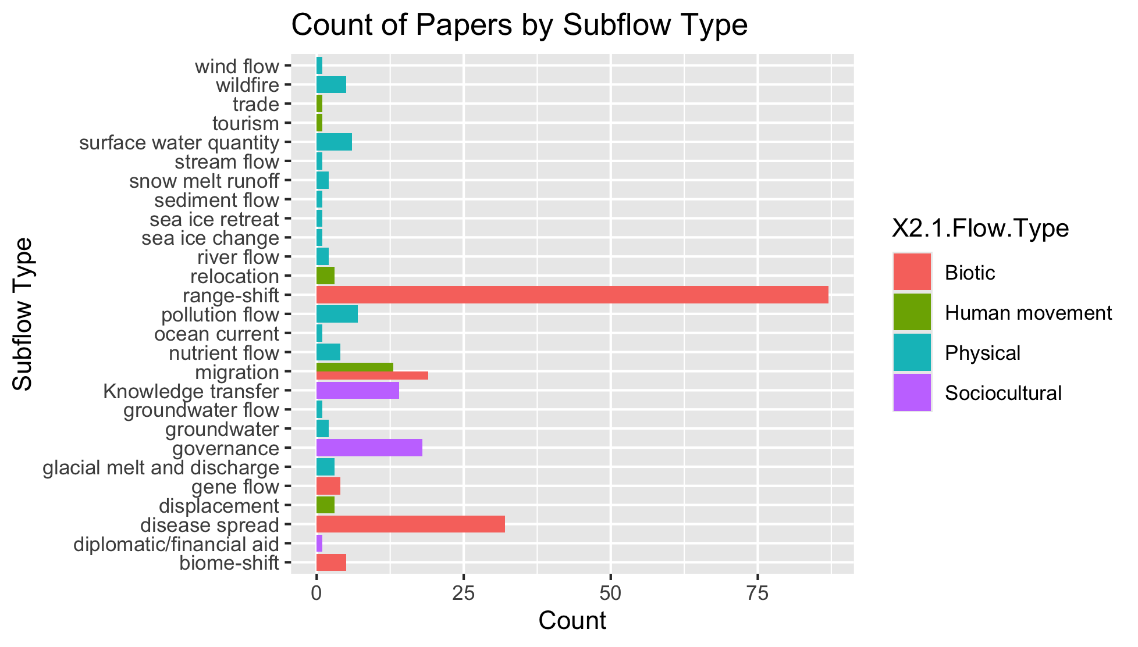
To group physical flow papers

Slide 19
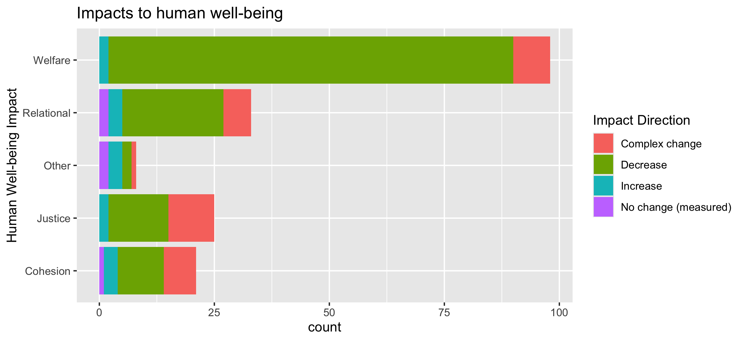
To align direction colors with final color pallet

Slide 20
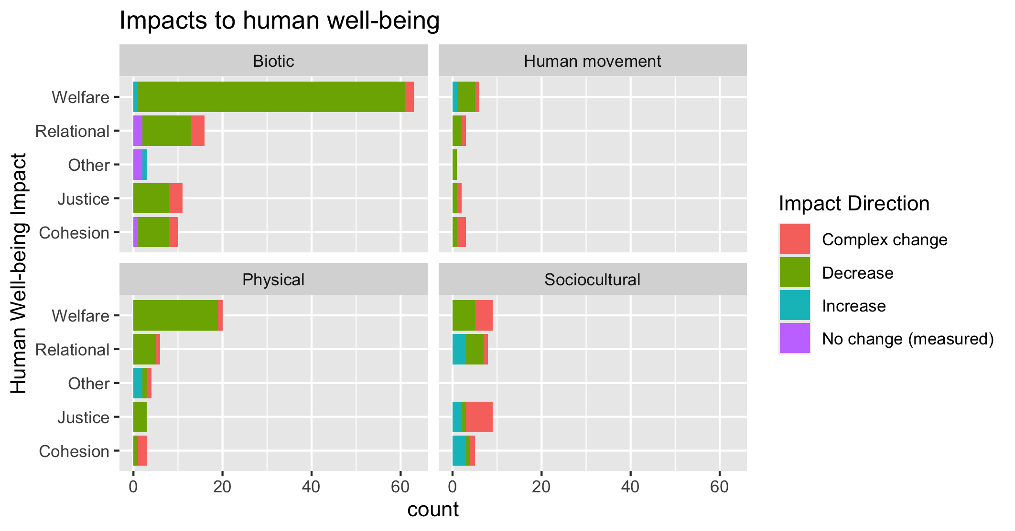
To align direction colors with final color pallet

Slide 21
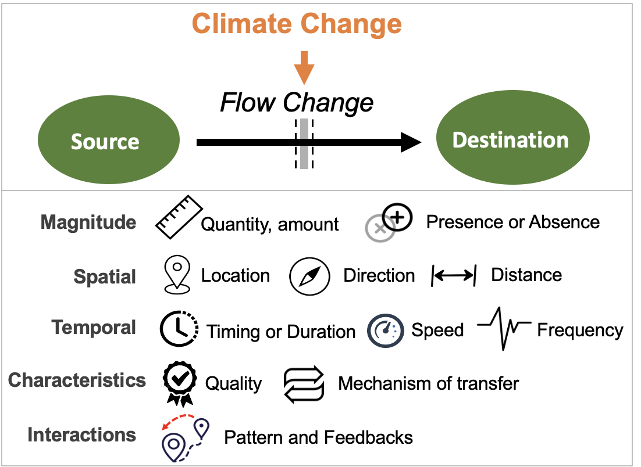
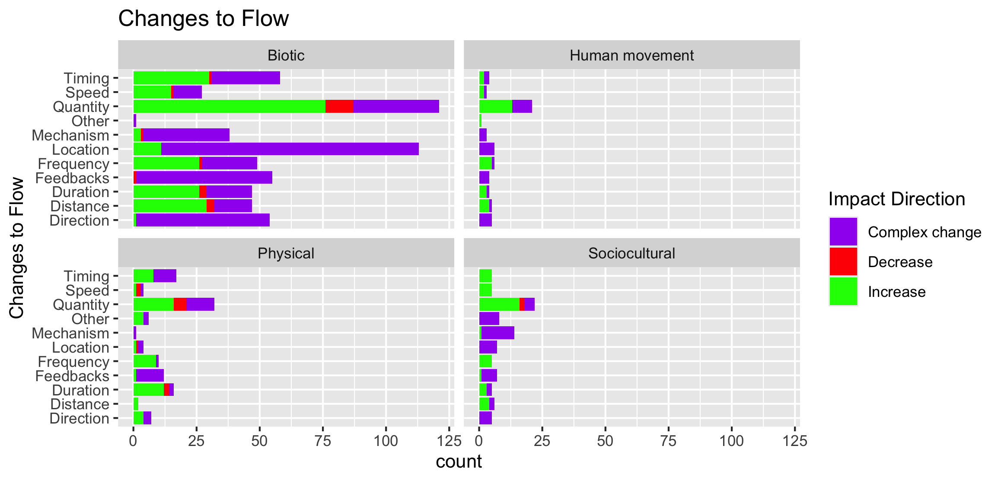

Slide 22
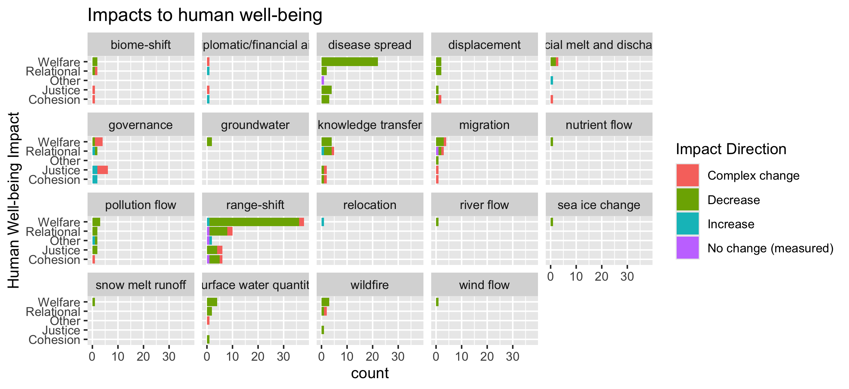
To group physical flow papers

Slide 23
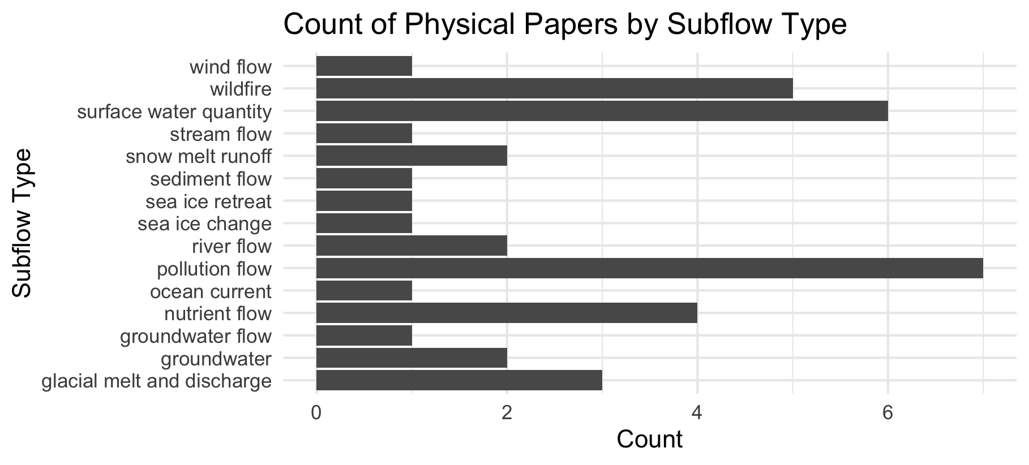

Slide 24
Feb 23 2025

Slide 25
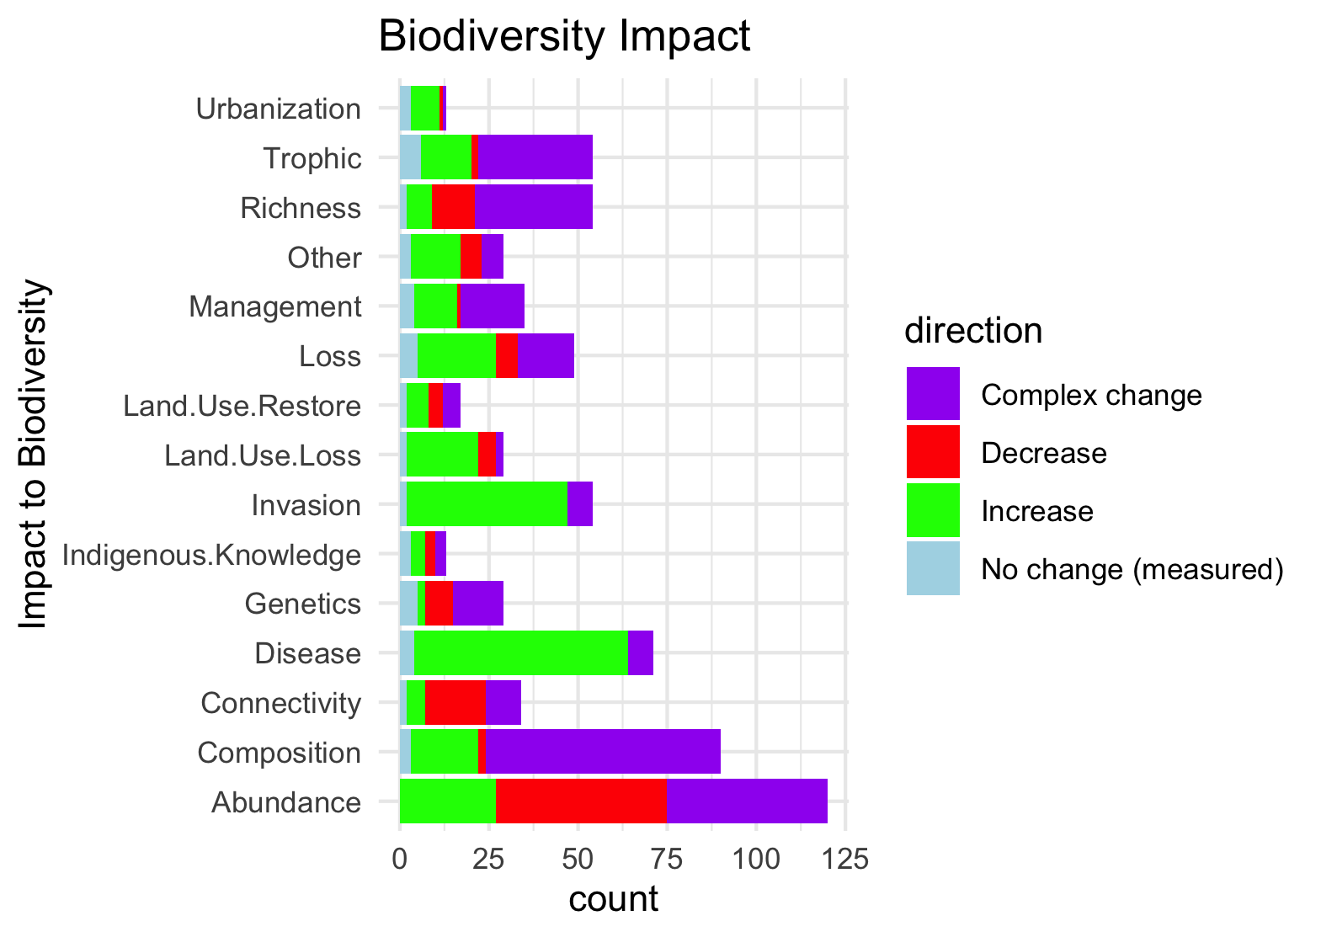
Needs to be grouped by what is good and what is bad to see increase in:

Slide 26
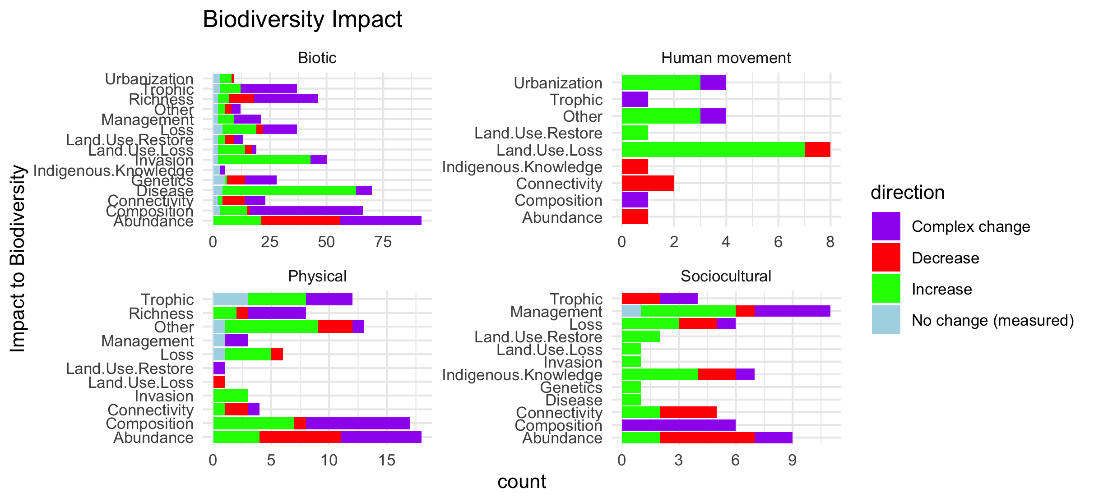
Scale free on the facet (diff x axis)

Slide 27
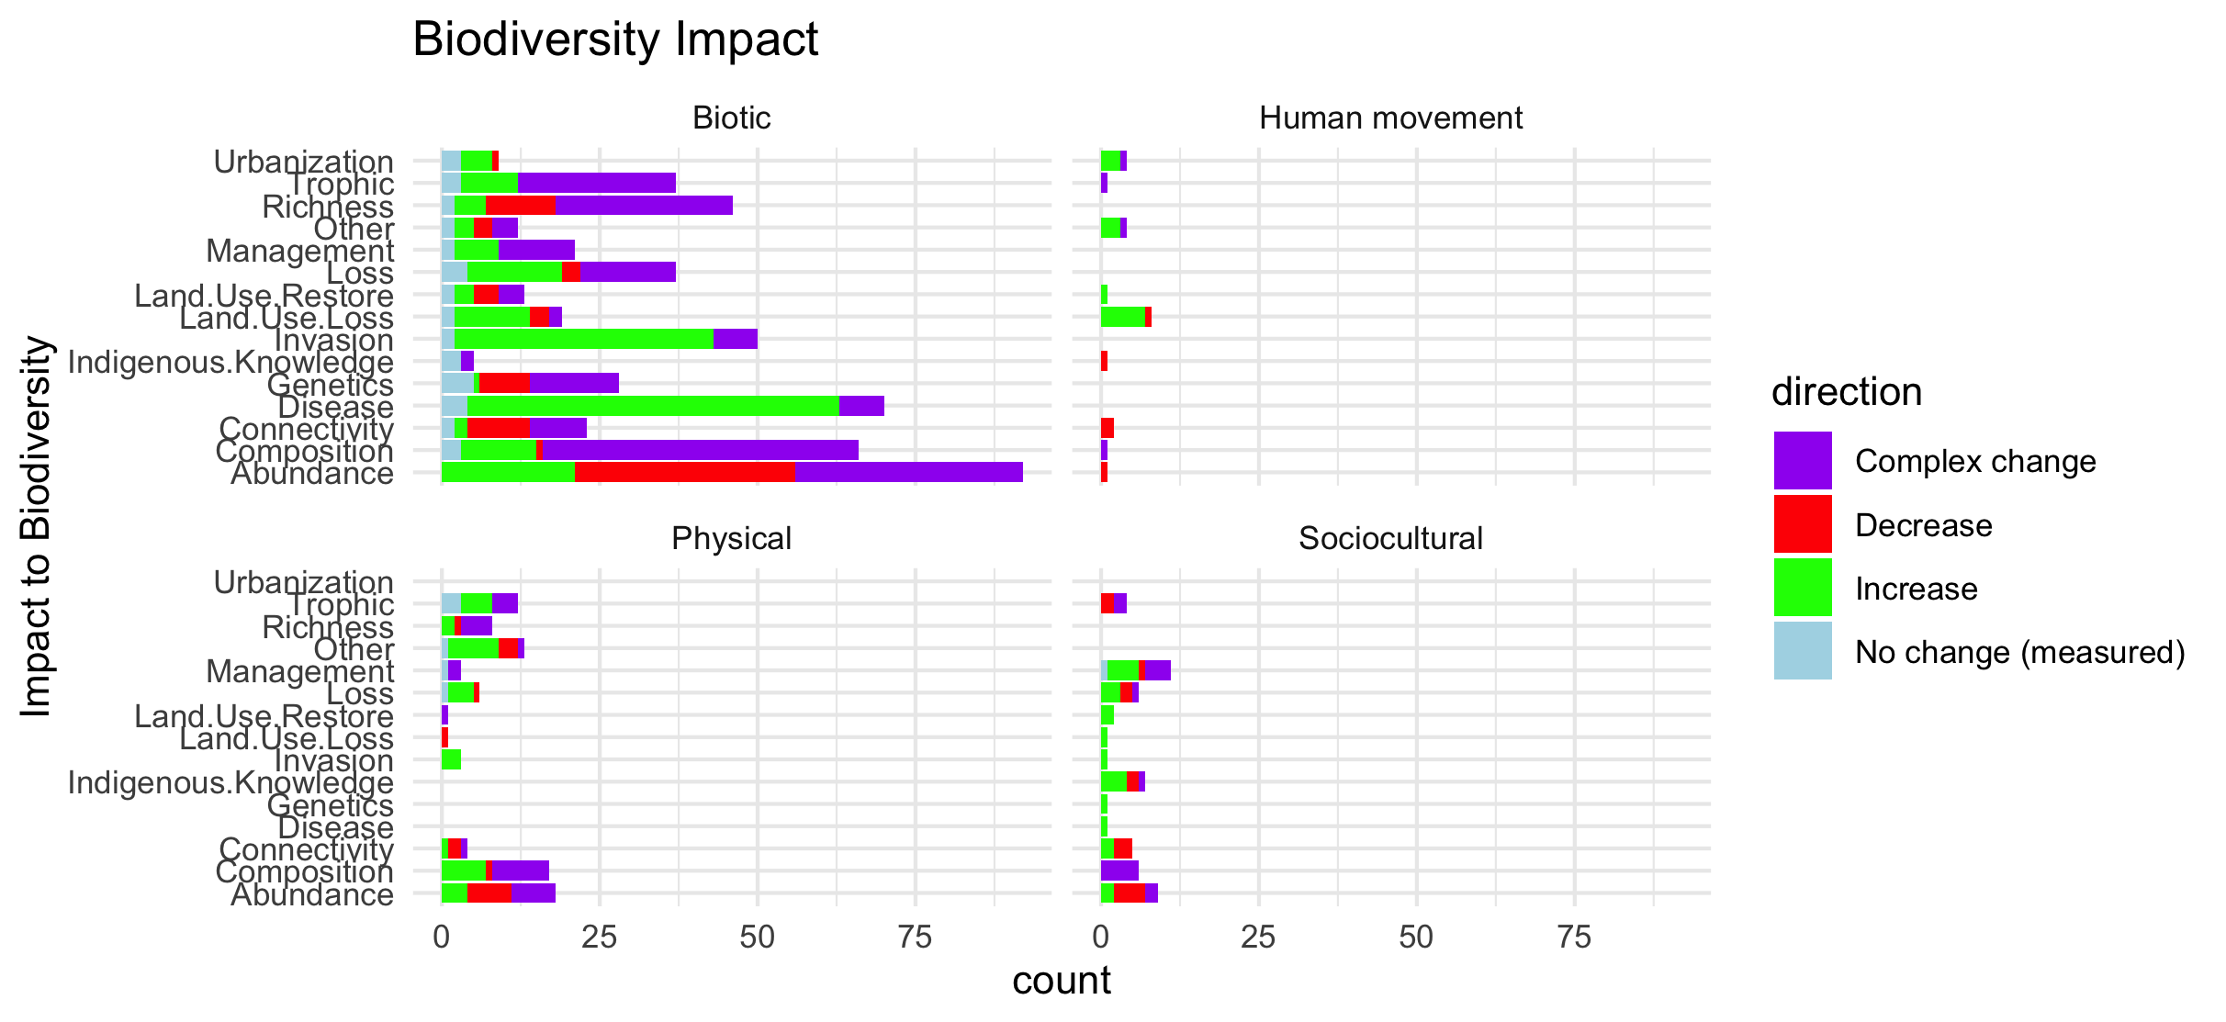
Scale fixed on the facet (same x axis)

Slide 28
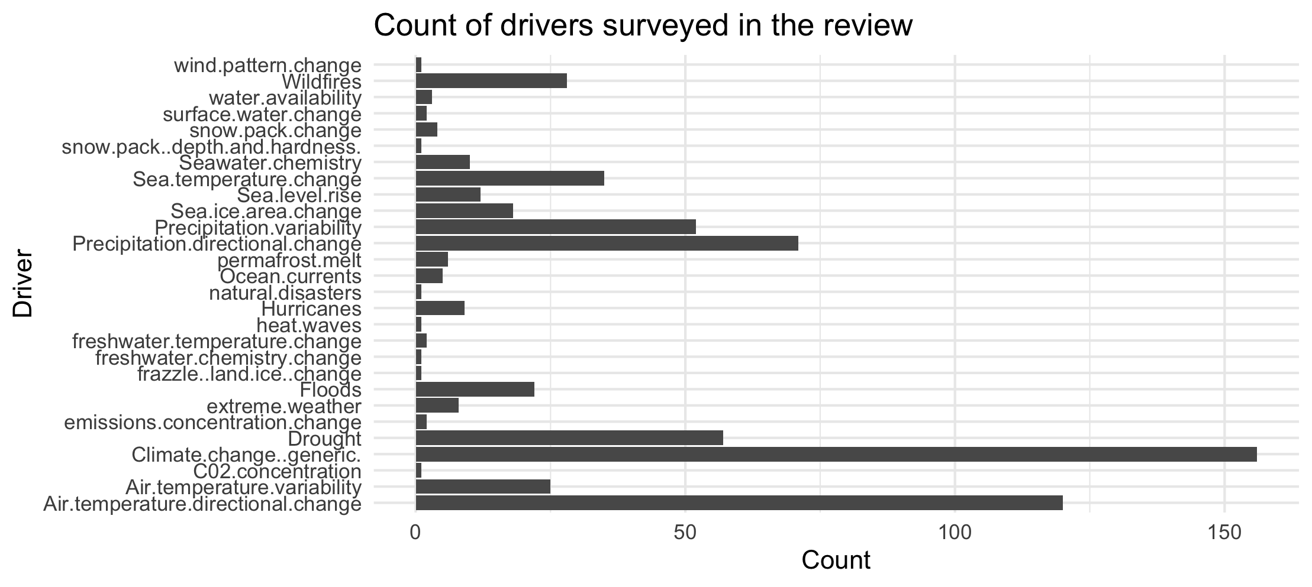

Slide 29
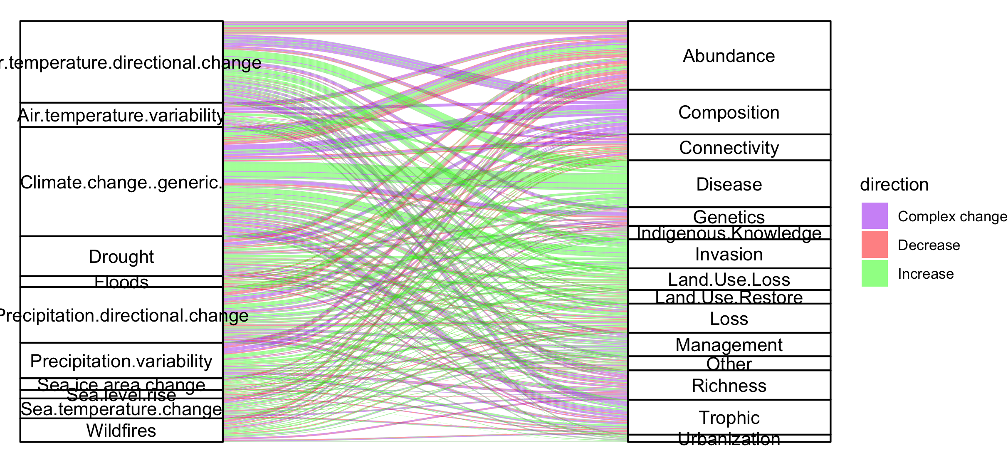
Colleen: see note isn the code – we could group spme of the drivers (hurricaines, extreme weather, ands ome of the ice ones). This still doesnt take into account if changes arw good or bad though and might just be too busy.

Slide 30
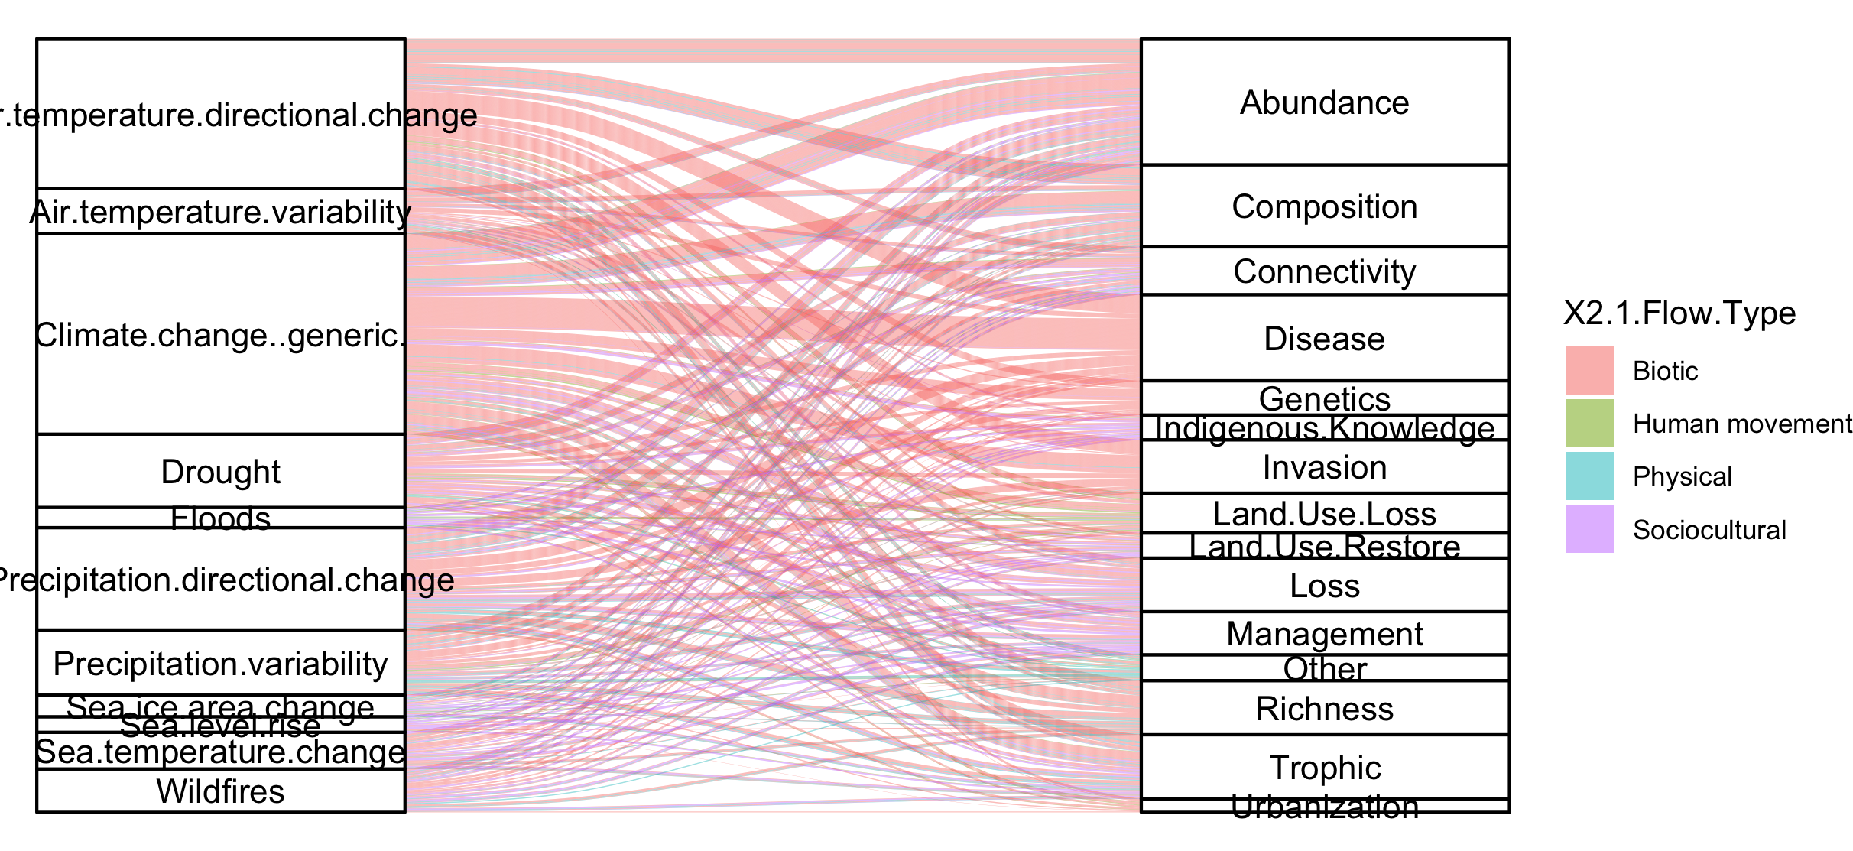
#not that informative because so many more of the papers are biotic

Slide 31
NCPs

Slide 32
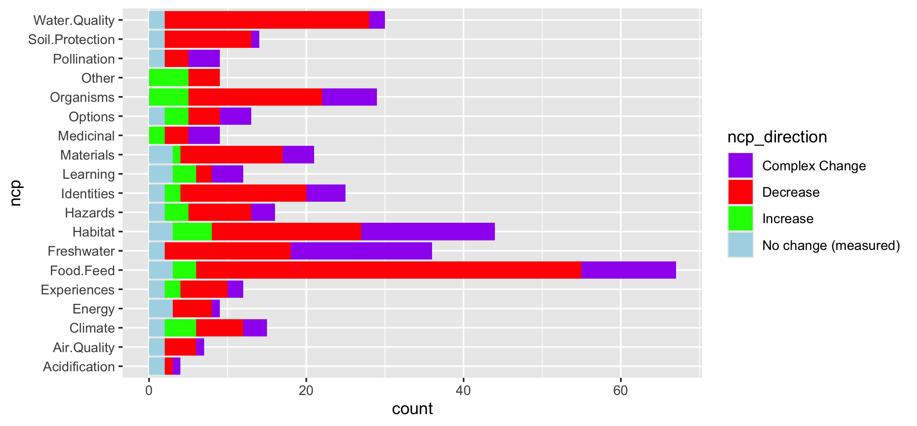
Fix labels

Slide 33
Do by flow type

Slide 34
Fix labels

Slide 35
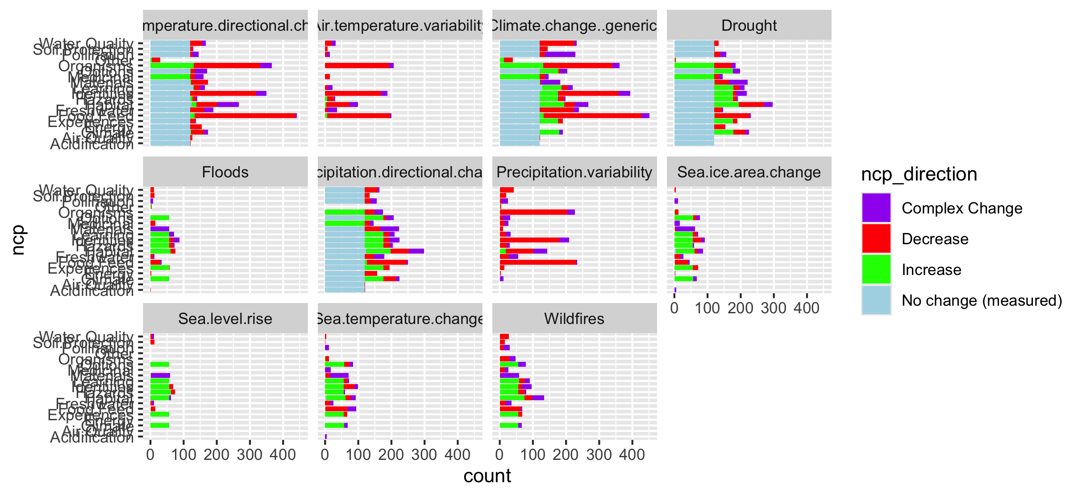

Slide 36
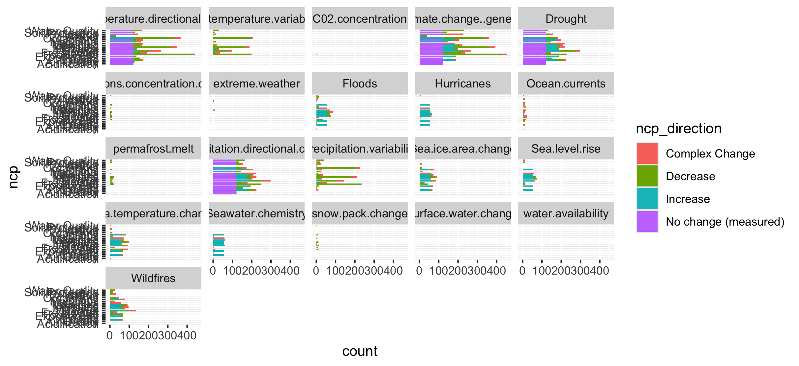
Too many drivers

Slide 37
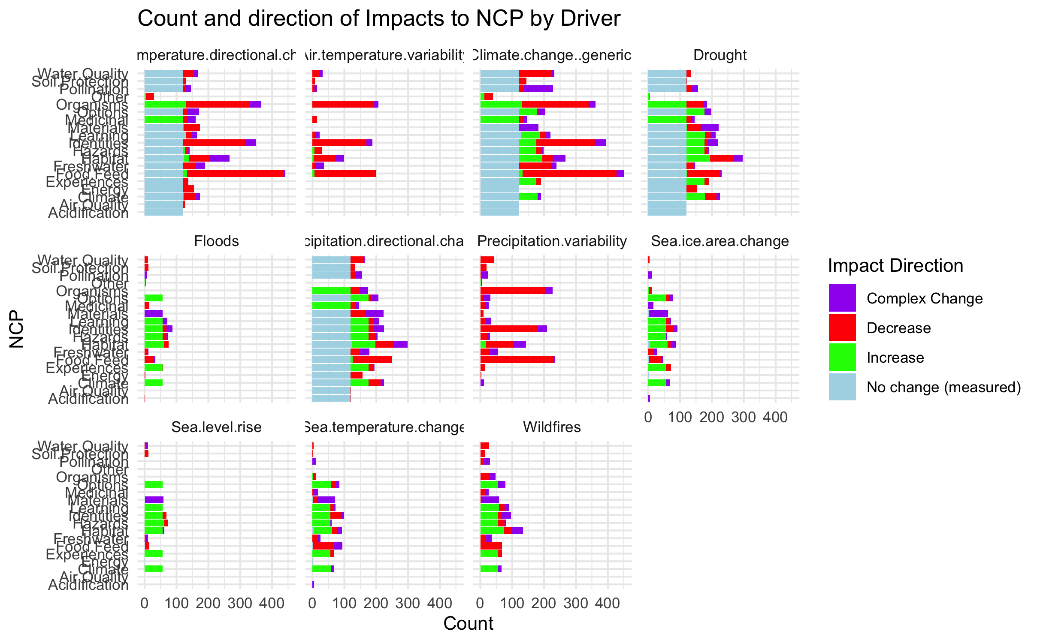

Slide 38
HWB

Slide 39
Connections – how does altered flow relate
Driver~ altered flow (by flow, and subflow – grouped out by flow
Altered flow~ impact (for each category)

